Slide 1

Post Harvest loss in Agriculture using Blockchain
Sl.Num. | Student Name | USN | Roll Num. | Division
1 | Pratham Shirol | 01FE21BCI018 | 117 | F-DIV
2 | Shravan B S | 01FE21BCI023 | 150 | F-DIV
3 | Yash S H | 01FE21BCI005 | 105 | F-DIV

Slide 2

INTRODUCTION
Blockchain technology, also known as distributed ledger technology (DLT), securely records and transparently shares transaction data across multiple computers. Each transaction is added to a digital ledger that is distributed across the network, ensuring security and resistance to tampering. In supply chain management, blockchain enhances transparency and efficiency by accurately tracking the provenance and movement of goods. This is particularly beneficial for addressing agricultural food loss, improving food security, economic stability, and environmental sustainability by reducing inefficiencies in the supply chain.

Slide 3
MOTIVATION
Address post-harvest losses causing food wastage, economic loss, and environmental harm. Traditional supply chain management lacks transparency and coordination. Blockchain offers a secure, transparent, and efficient solution to transform agricultural supply chains, reduce food loss, improve efficiency, and promote sustainability, contributing to global food security and environmental conservation.

Slide 4
PROBLEM STATEMENT
Develop a blockchain-based solution to track and manage post-harvest losses in agriculture, focusing on enhancing supply chain transparency and recording accurate post-harvest data.
OBJECTIVES
Implemented blockchain for end-to-end traceability of agricultural products.
Used smart contracts to automate processes and streamline stakeholder information exchange.
Integrated IoT devices for real-time monitoring of environmental conditions.
Developed incentives to promote sustainable agriculture and minimize waste.
Use advanced analytics and predictive modeling to improve logistics and forecast demand.

Slide 5
SDG ALIGNMENT
This research aligns with SDG 12: Responsible Consumption and Production. By implementing a blockchain-based system to enhance traceability, improve coordination, prevent spoilage, and promote sustainable practices, the study aims to significantly reduce post-harvest losses in the agricultural supply chain. This contributes to more efficient use of resources and reduction of food waste, supporting sustainable consumption and production patterns.

Slide 6
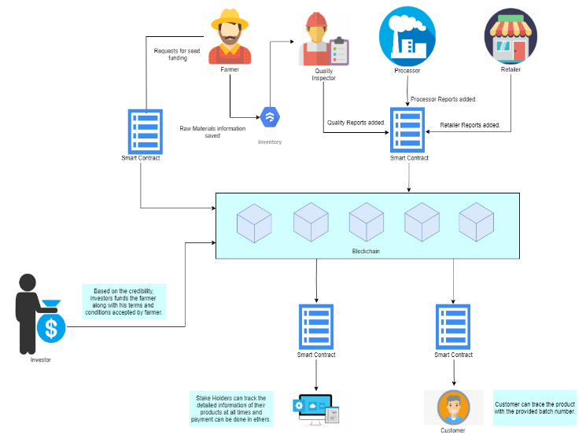
PROPOSED METHODOLOGY

Slide 7
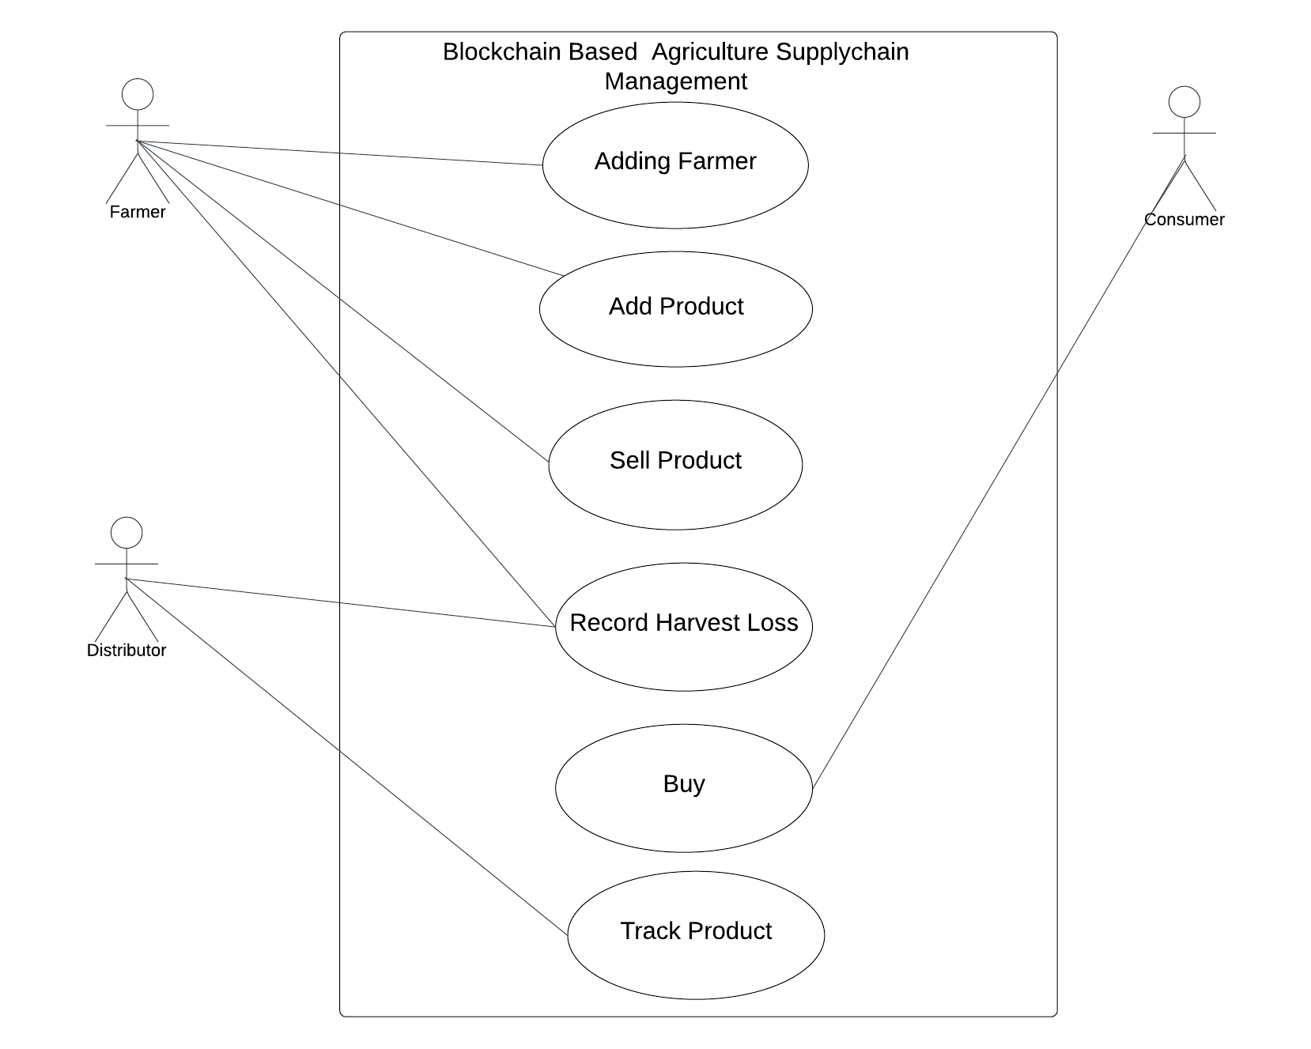
Use Case Diagram

Slide 8
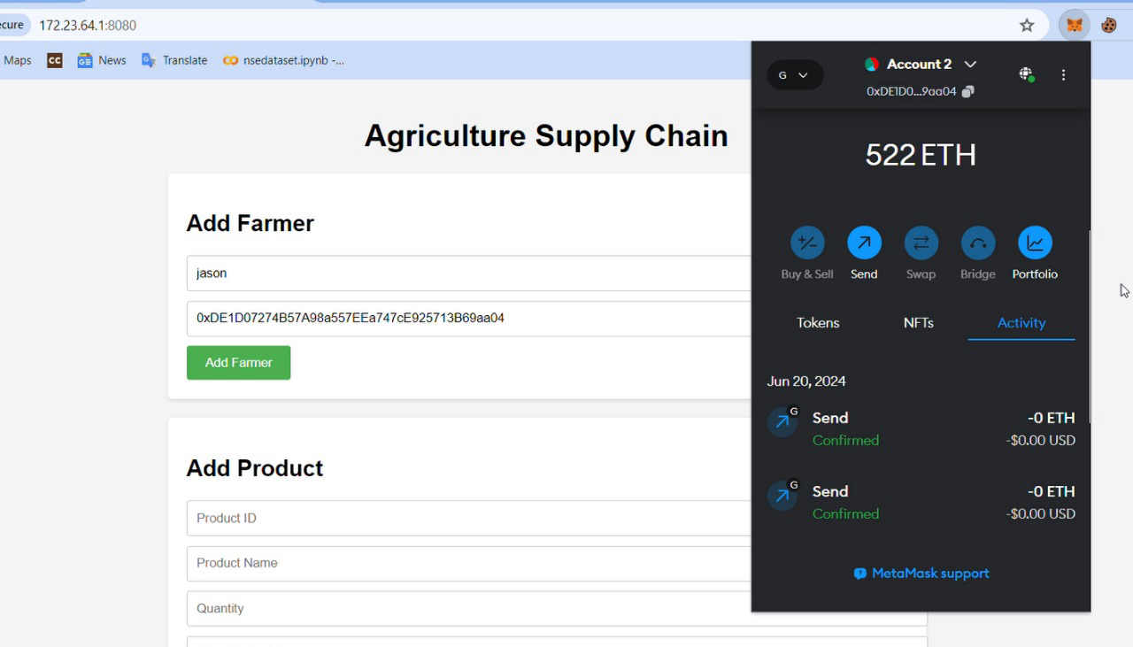
Adding Farmer
RESULTS

Slide 9
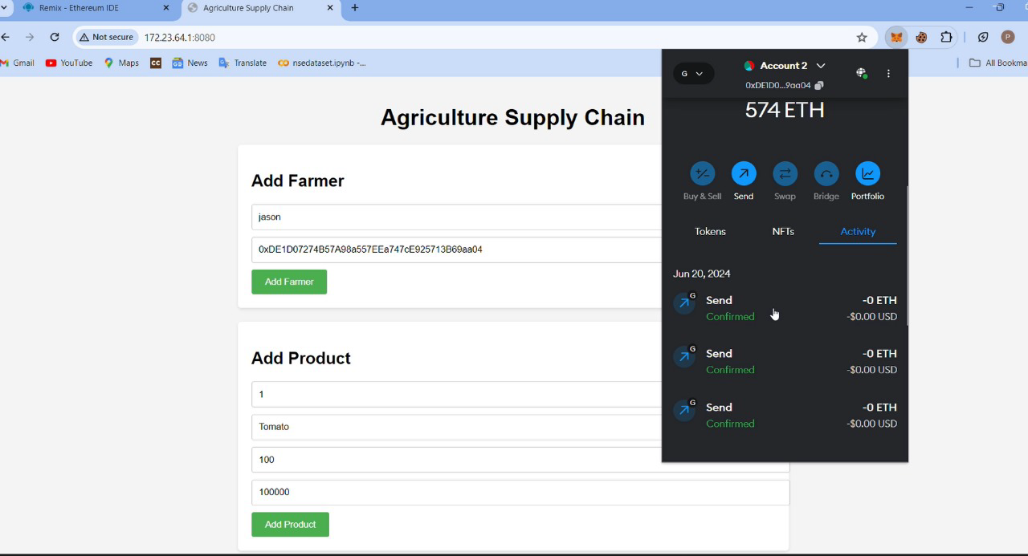
Adding Product

Slide 10
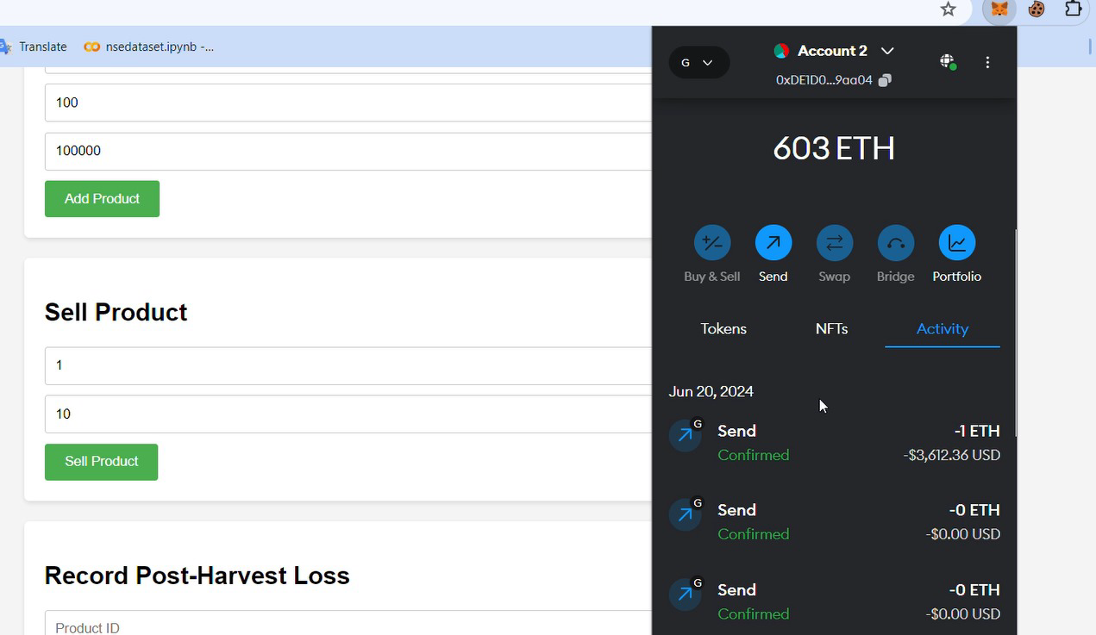
Selling Product

Slide 11
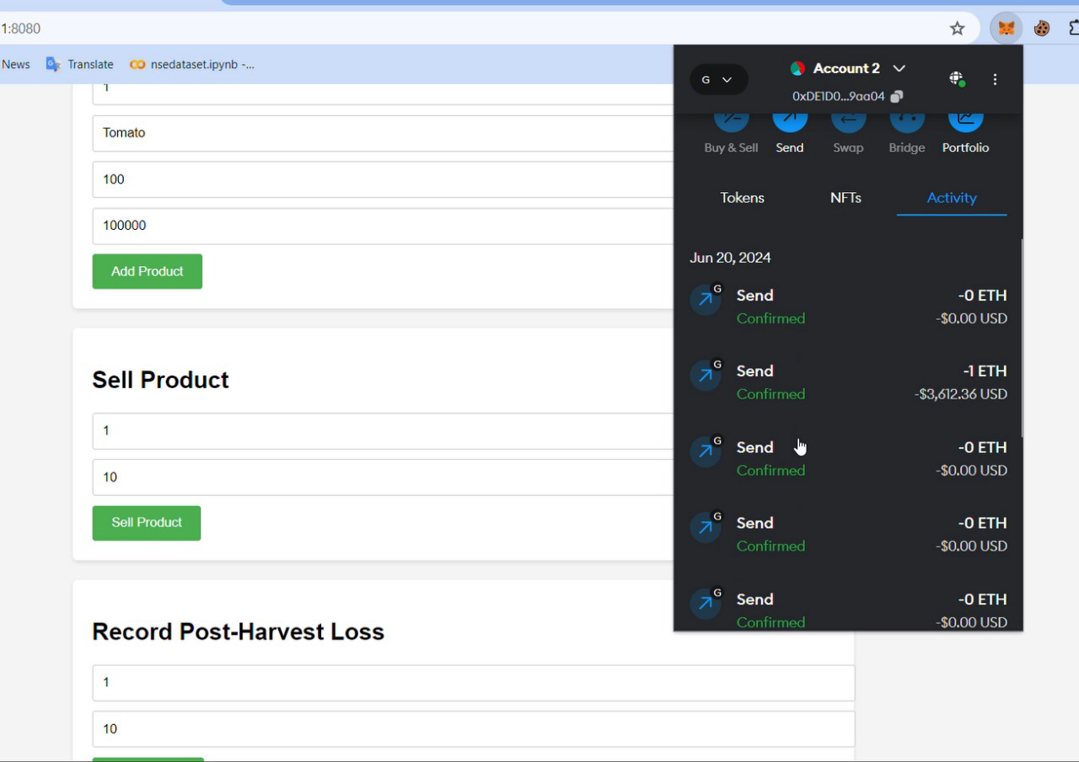
Harvest Loss Recorded

Slide 12
THANK YOU

